Slide 1
Installing Oracle Database XE 21c And The Sample Oracle HR Schema

Slide 3
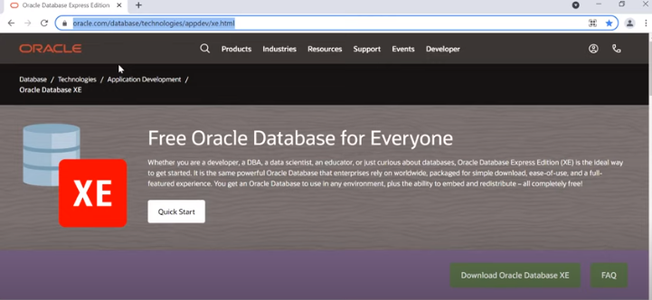

Slide 4
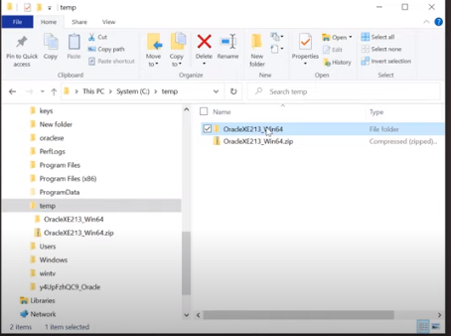

Slide 5
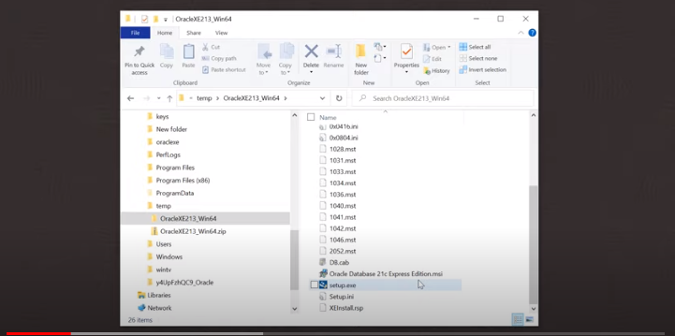

Slide 6
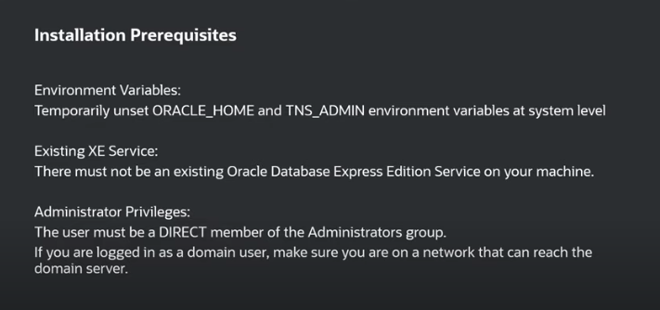

Slide 7
Notes:
Run setup.exe

Slide 8
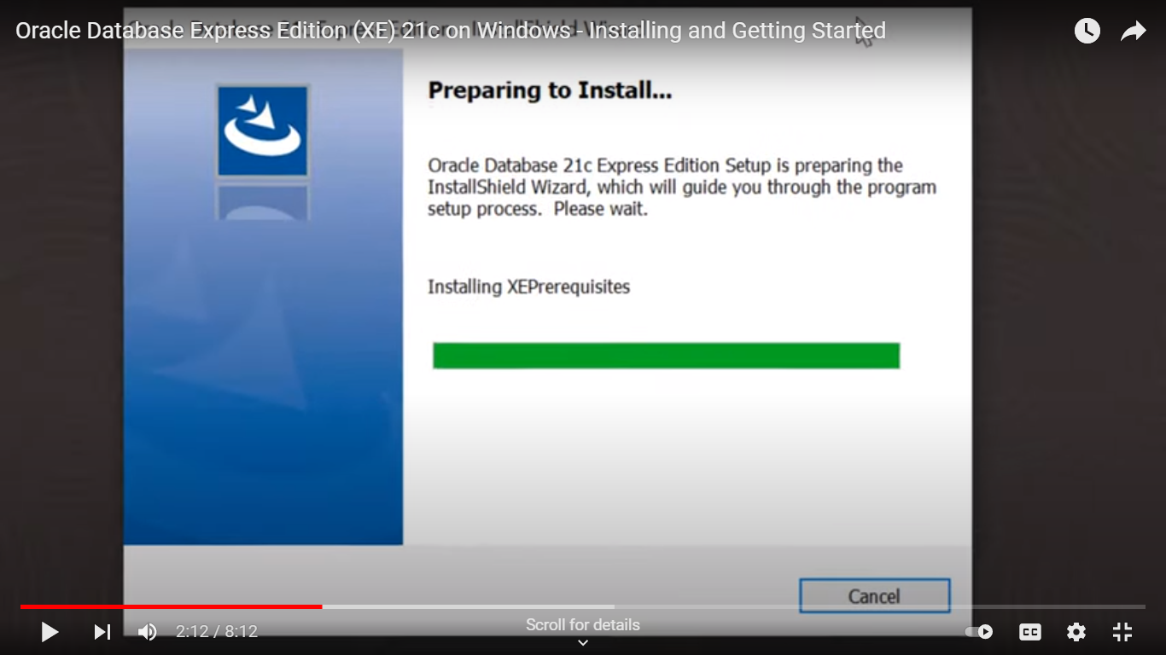

Slide 10
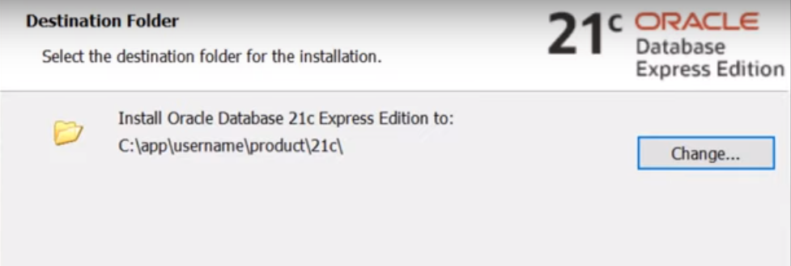

Slide 11
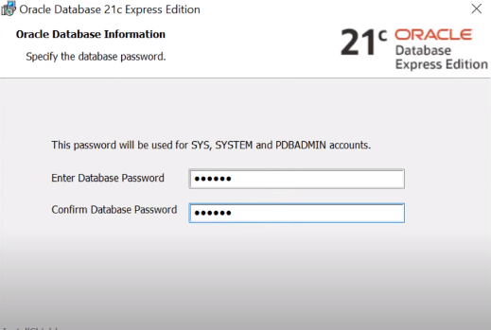

Slide 12
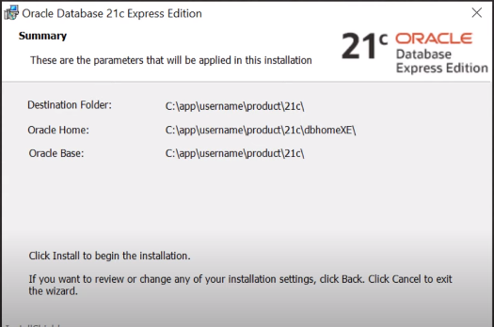

Slide 13
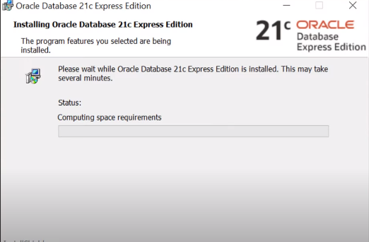

Slide 14
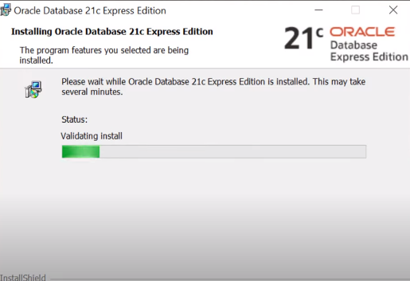
Notes:
20 - 30 ms

Slide 16

Demo
Testing the Oracle Database 21c installation

Slide 17
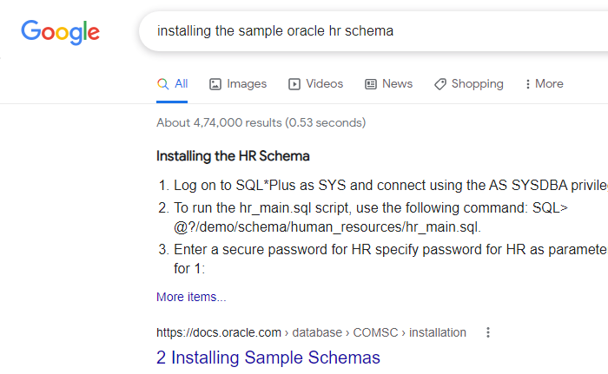
Installing The Sample Oracle HR Schema

Slide 18
https://docs.oracle.com/en/database/oracle/oracle-database/21/comsc/installing-sample-schemas.html#GUID-3820972A-08D7-4033-9524-1E36676594EE
To find the latest version of the sample schemas installation scripts, go to the following GitHub location:
https://github.com/oracle/db-sample-schemas/releases/latest

Slide 19
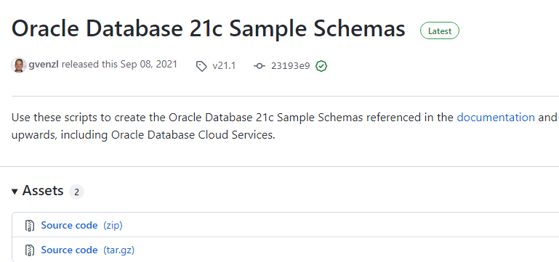

Slide 20
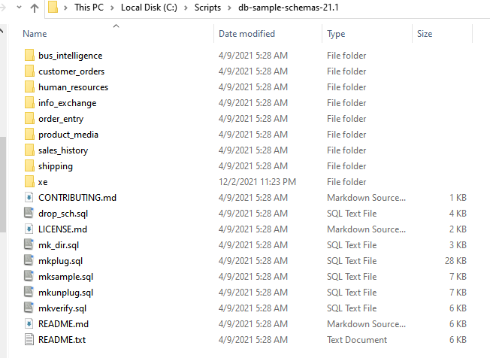
Unzip to a directory with no spaces in the name

Slide 21
Demo
Installing The Sample Oracle HR Schema

Slide 22
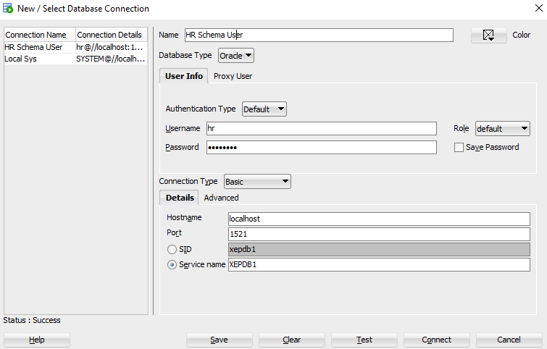
Create a new connection in SQL Developer

Slide 23
Test the connection

